Slide 1

AI-NATIVE DATA APPLICATIONS WITH SQL MCP
Microsoft Build 2026, June 14 | Kathmandu, Nepal
Nabaraj Ghimire | Principal Software Engineer, SELISE Group

Slide 2


02
WHY THIS TOPIC
MATTERS
Enterprise data is locked inside databases.
1
2
SQL is the universal standard language for relational databases and enterprise data.
MCP: open standard by Anthropic (Nov 2024) connecting AI models to external tools and data with a common protocol instead of custom integrations for every system.

Slide 3

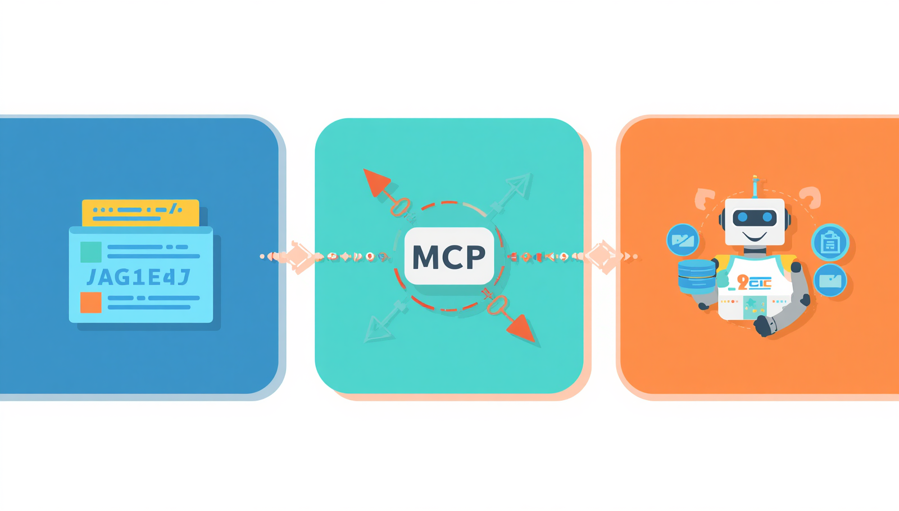
03
WHY MCP MATTERS
Users now expect conversational access to data. Instead of asking IT guy for a new report, users want to ask: “Find inventory items with missing documents.”
1
Normal chatbots cannot safely access live databases.
2
AI apps need live enterprise data, not static training data.
3
AI-native data applications are built around user intent, natural language, and tool execution.

Slide 4
04
TRADITIONAL VS AI-NATIVE DATA APPS
1.
Traditional applications need fixed screens, reports, dashboards, or APIs before users can access that data.
2.
Every new business requirement usually needs a new API, report, stored procedure, or UI change.
3.
The user asks what they want to know or do, and the AI application selects the correct backend tool.
4.
SQL MCP allows the AI application to interact with a database through controlled tools instead of direct database access.
5.
The .NET MCP server becomes the secure execution layer between Claude Desktop and SQL Server.
6.
The engineering focus shifts from only building screens to building safe, reusable, authorized data tools.

Slide 5

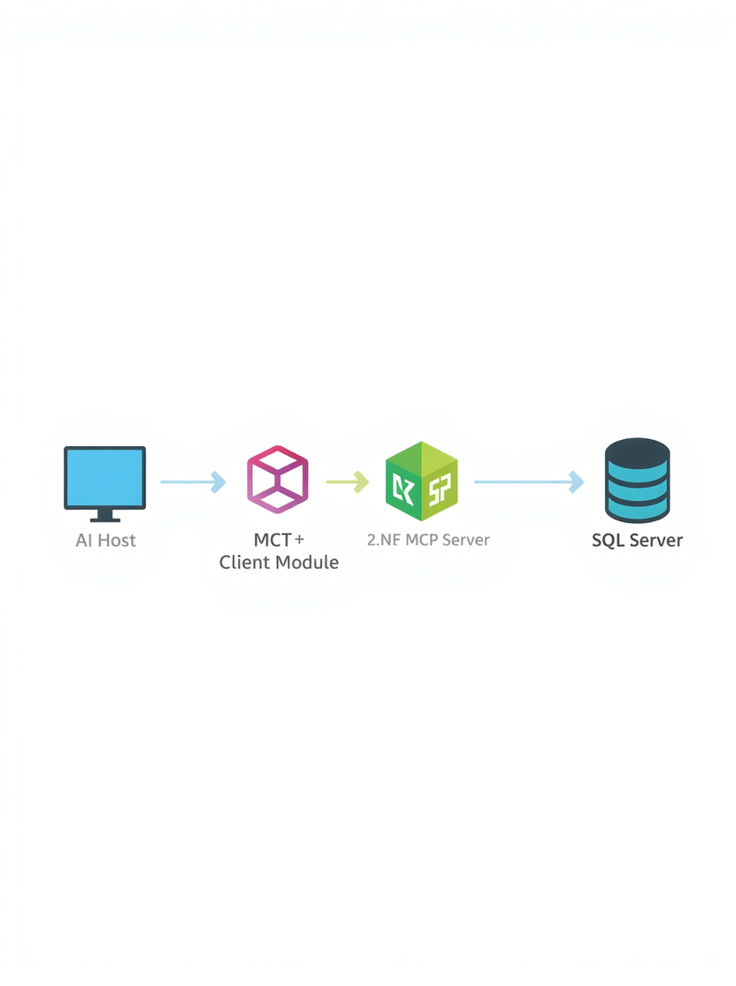
05
SQL & MCP FUNDAMENTALS
PART 2: ARCHITECTURE
Standard protocol for connecting AI apps to tools, data sources, and workflows.
1
2
3
4
Claude Desktop acts as the MCP Host.
Host initiating requests through the MCP Client to the .NET MCP Server.
.NET MCP Server exposes controlled ops: read, update, delete, search, and explain schema, no raw SQL.
SQL Server receives only validated, parameterized queries built by the MCP server after auth and audit checks.

Slide 6
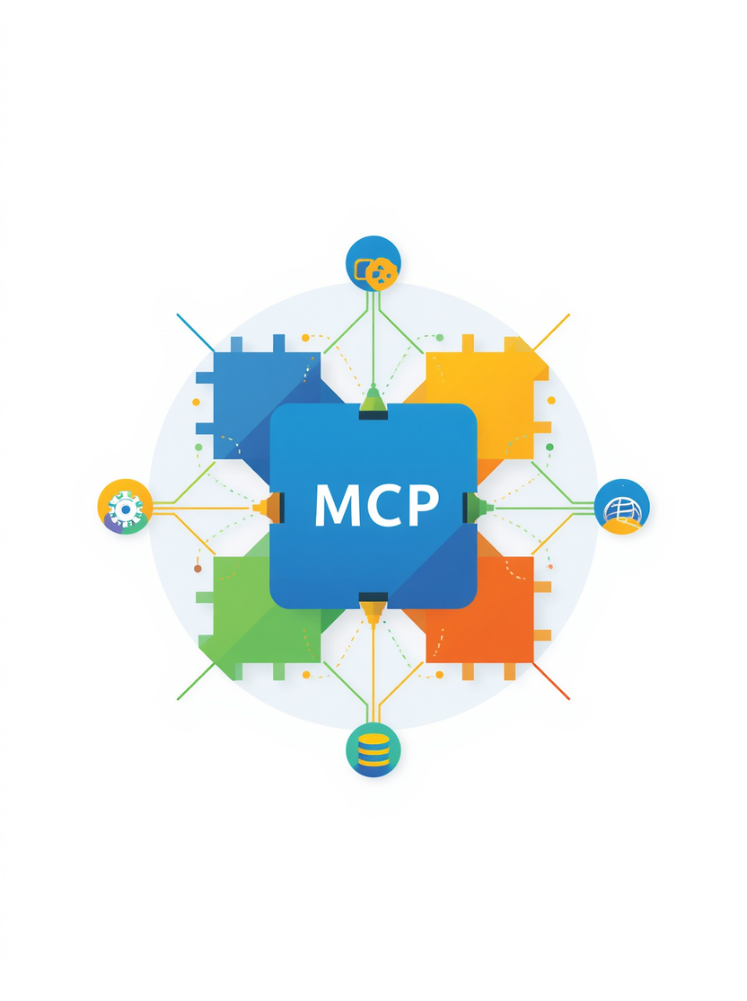
06
MCP BUILDING
BLOCKS
MCP core elements enable AI apps to connect, communicate, and operate safely with databases and external systems via a standard interface.
🛠
📦
⚡
Tools: Actions AI can invoke eg. read_record, update_record, delete_record, search_customer
Resources: Metadata, schema info, allowed entities, and documentation exposed to the AI
Prompts & Transport: Reusable instruction templates + STDIO/HTTP via JSON-RPC messages

Slide 7

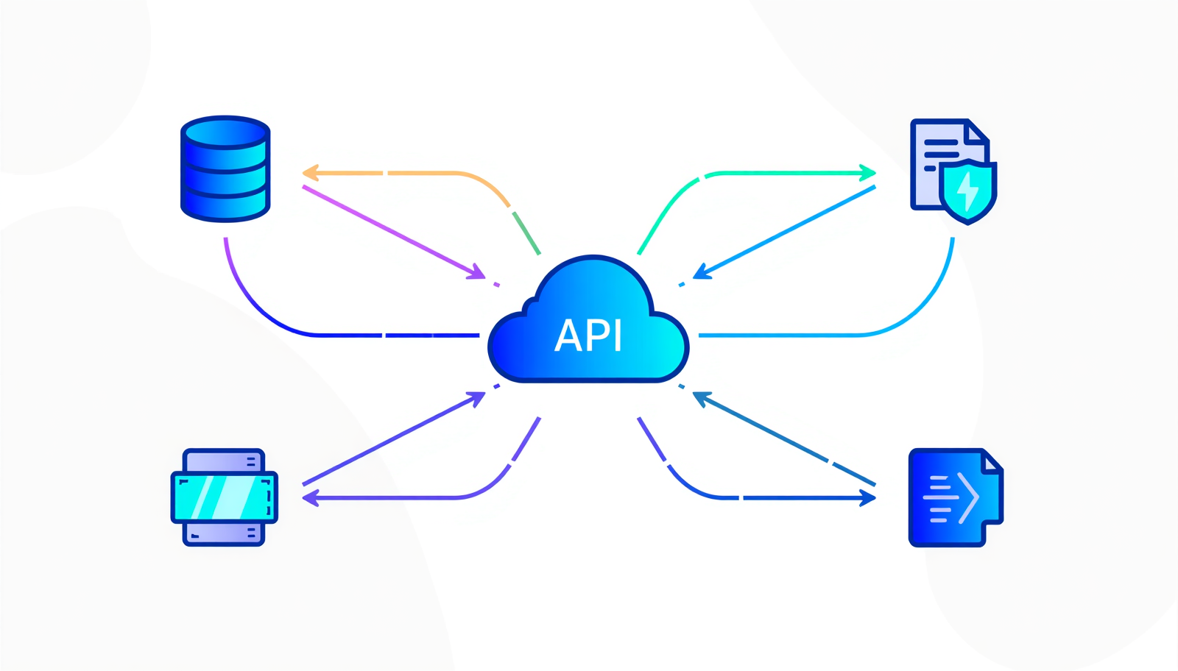
07
MCP ECOSYSTEM & SUPPORTED INTEGRATIONS
MCP connects AI applications to a wide range of external systems through a standardized protocol interface. Rather than converting natural language directly to SQL, the LLM selects the appropriate MCP tools, enabling safe, governed access across databases, APIs, file systems, and business applications without exposing raw query execution.
1
Data & Storage: SQL Server, file systems, cloud storage, structured & unstructured data sources via controlled MCP tools.
2
APIs & Business Apps: REST APIs, SaaS platforms, ERP & CRM systems, developer tools — all integrated through standard MCP interface.
3
Key Note: MCP does NOT convert natural language to SQL directly. The LLM selects backend tools dynamically based on intent and context.

Slide 8

08
SQL MCP CONCEPT
SAFE & GOVERNED ACCESS
Designed as a governed database access layer, not as unrestricted natural-language-to-SQL execution.
1
2
3
User Request → Claude Intent: Natural language input is understood by the LLM; intent is mapped to an appropriate MCP tool.
MCP Tool Selection → .NET Server Validation: Server enforces authorization, business rules, allowed tables, and query constraints.
Query Builder → SQL Server → Result: Parameterized query is built, executed safely, and result is returned to Claude for response.

Slide 9
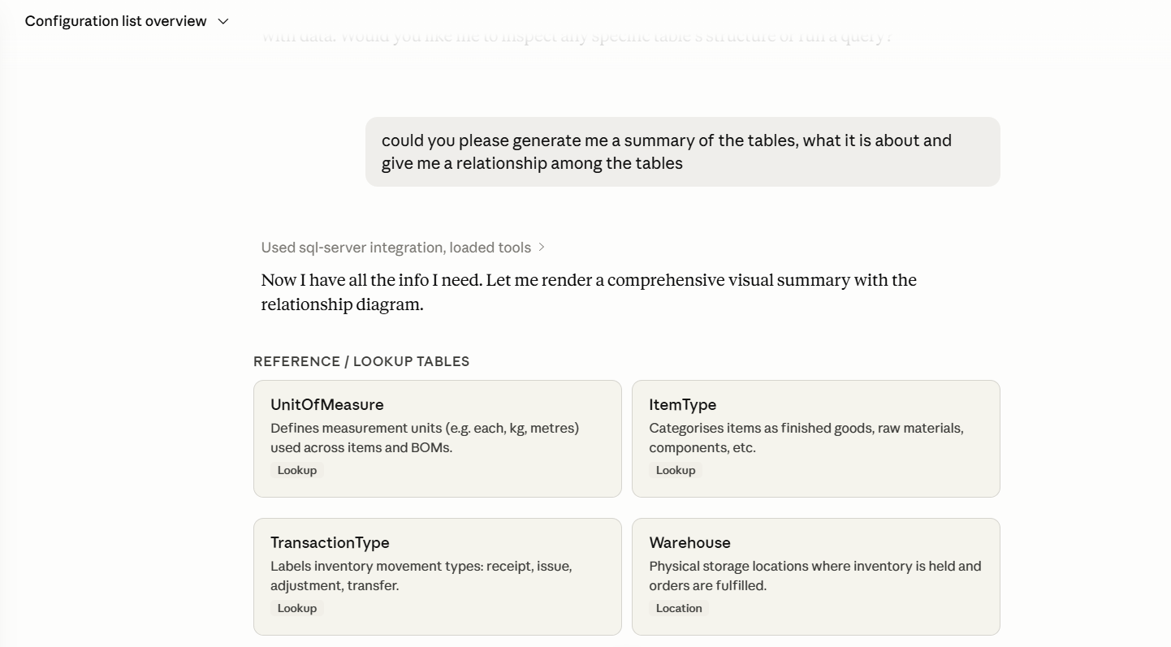
09

Slide 10
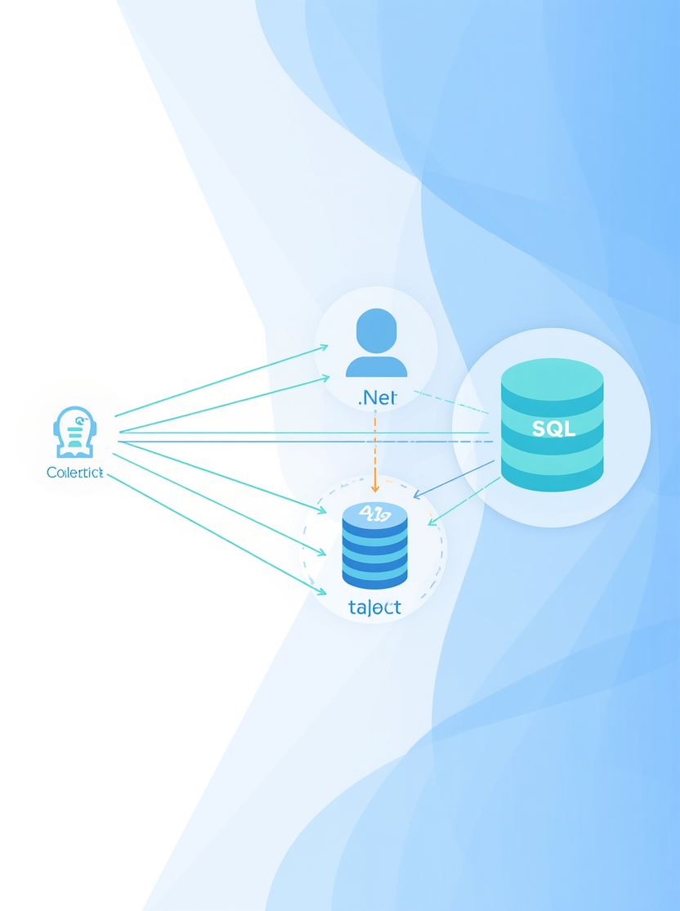
10
REFERENCE ARCHITECTURE
SQL MCP ECOSYSTEM
Claude Desktop → MCP Client → .NET MCP Server → SQL Server. The .NET MCP Server acts as a secure, governed boundary handling all critical responsibilities between AI and data.
1
2
3
Auth & Validation: Authentication, authorization, input validation, and business rules enforcement at the MCP server layer.
Query & Execution: Safe query building with parameterized queries, execution against SQL Server, and result formatting.
Logging & Response: Audit logging, monitoring, execution tracing, and structured response formatting back to Claude.

Slide 11
11
WHY .NET ENGINEERS SHOULD CARE
1.
MCP server acts as a backend integration boundary, replacing traditional web UI endpoints and serving as the new entry point for AI-driven data access.
2.
Control exactly which tools are exposed to the AI model define allowed database operations and restrict access to only what is necessary.
3.
Manage user permissions at the MCP server layer enforce role-based access, claims, and policies without changing existing database schemas.
4.
Own the query building logic entirely in .NET no raw SQL from the model, full control over parameterization, filtering, and safe query construction.
5.
Apply result filtering before data reaches the AI model enforce field-level and row-level restrictions to prevent sensitive data leakage.
6.
Built-in auditing capabilities: log every tool call, input argument, generated query, and result enabling compliance, monitoring, and forensic analysis.

Slide 12
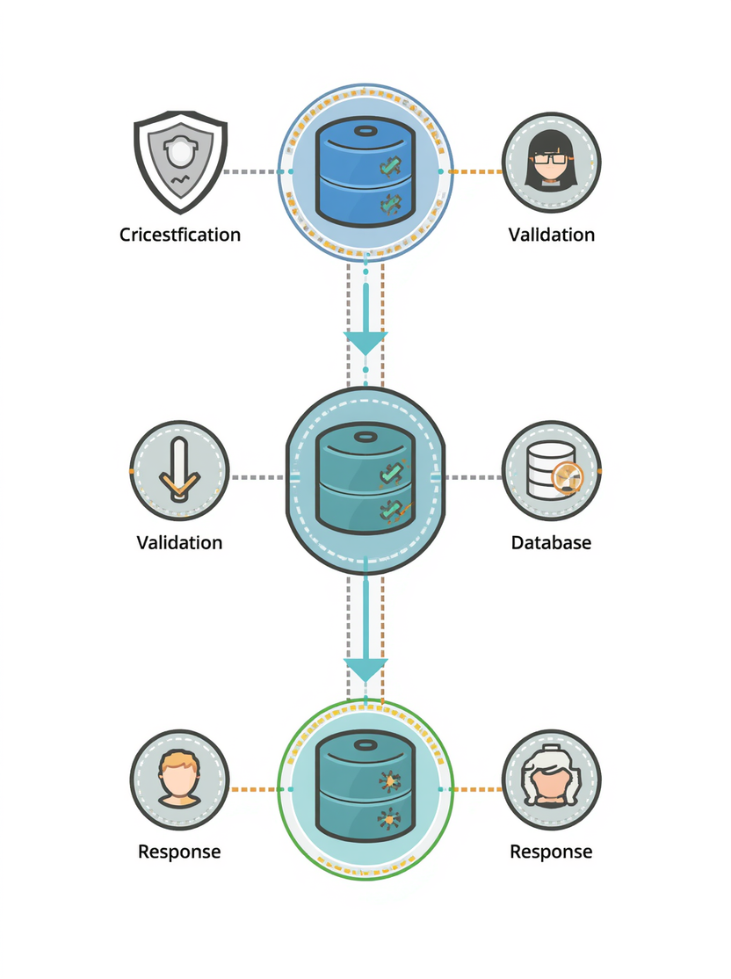
12
MCP SERVER
RESPONSIBILITIES
Example: "Show customer records in table format" Claude receives prompt, model decides DB data is needed, MCP client calls .NET MCP server tool, server queries SQL Server and returns data, Claude renders final answer as Markdown/table.
1
2
3
Expose tools & validate input; authenticate caller, check permissions, verify arguments against allowed schema.
Authorize action & execute DB operation; apply row/field-level rules, build parameterized query, run against SQL Server.
Return result & log audit trail; format response for Claude, log tool call, arguments, SQL, rows affected.

Slide 13

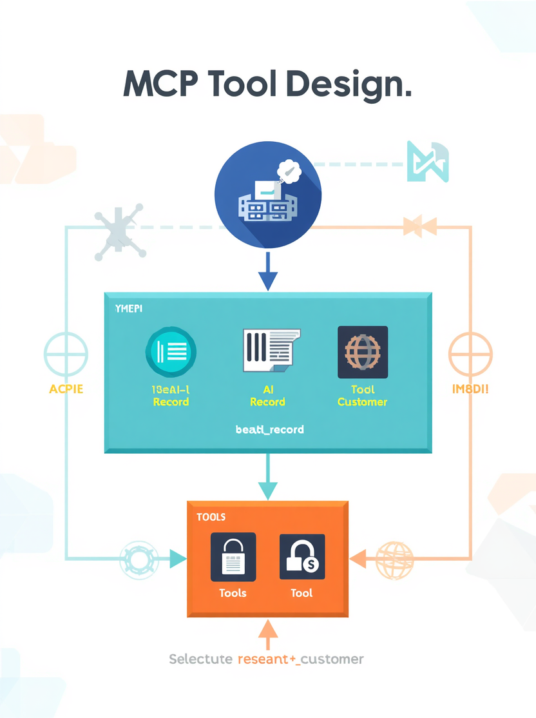
13
TOOL DESIGN
FOR SQL MCP
The MCP server exposes prompts and tools with descriptions and schemas. The host or model selects tools based on input schema and context. no automatic prompt to tool router.
1
2
3
Server exposes tools with clear names, descriptions, and input schemas for AI model discovery.
Host or model selects tools based on input schema, context, and user intent at runtime.
Server enforces allowed operations — no automatic prompt-to-tool routing permitted.

Slide 14
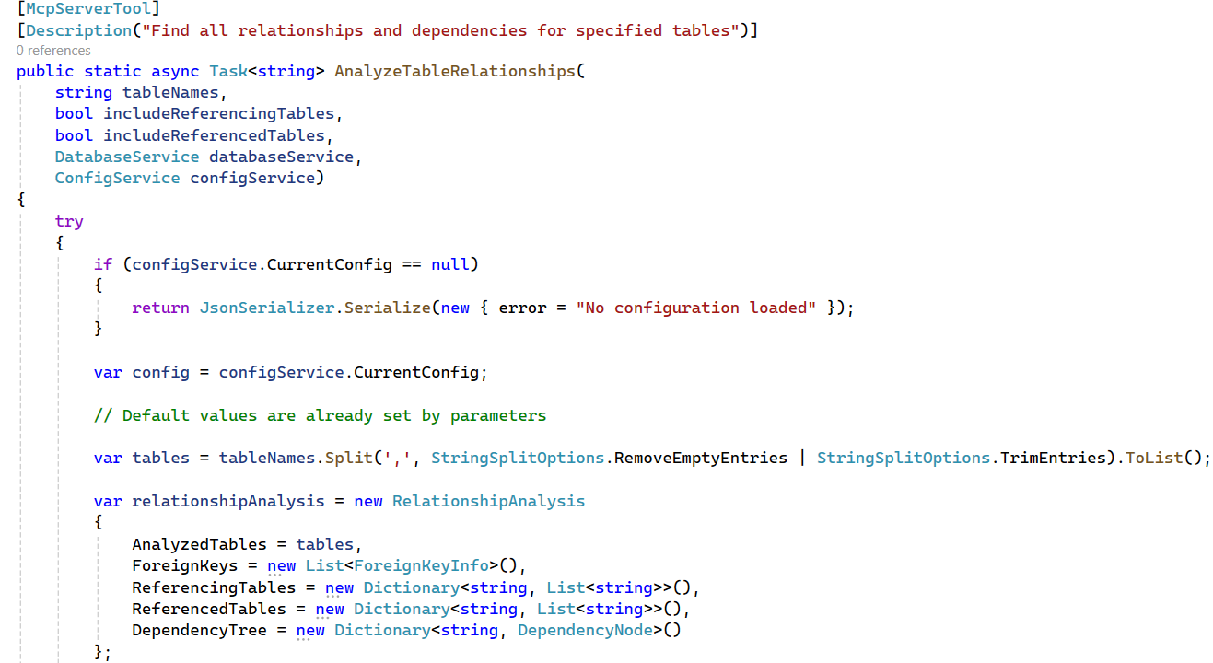
14

Slide 15
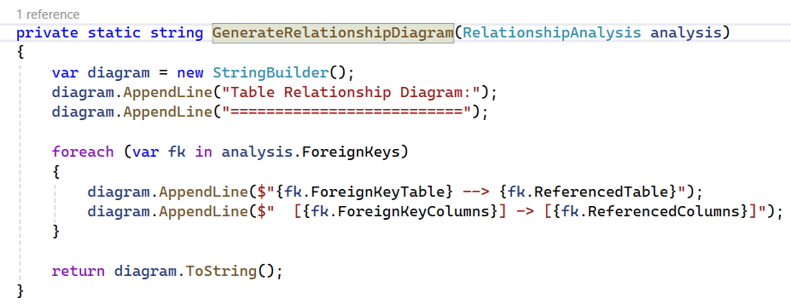
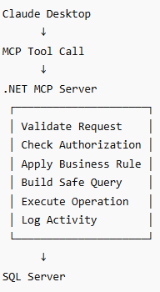
15
which generates the output
something like this:

Slide 16

16
HOW NATURAL LANGUAGE BECOMES ACTION
1.
User Prompt
The user types a natural language request (e.g., "Show me all customers from Kathmandu") into Claude Desktop or an AI-native app interface.
2.
LLM Intent Understanding
The LLM analyzes the prompt, identifies the user's intent, and determines that a database tool call is required to fulfill the request.
3.
Tool Selection
Based on tool name, description, input schema, and context, the model selects the most appropriate MCP tool (e.g., search_customer) exposed by the .NET MCP server.
4.
JSON Argument Conversion
The LLM converts the natural language intent into structured JSON arguments (table, filters, columns, action type) and the MCP client calls the .NET MCP server tool.
5.
Server Validation & Authorization
The .NET MCP server validates inputs, enforces business rules, checks user permissions and roles, and ensures only allowed operations proceed.
6.
Safe SQL Execution & Response
A parameterized query is built and executed against SQL Server. Results are returned to Claude, which renders a user-friendly Markdown or table response.

Slide 17
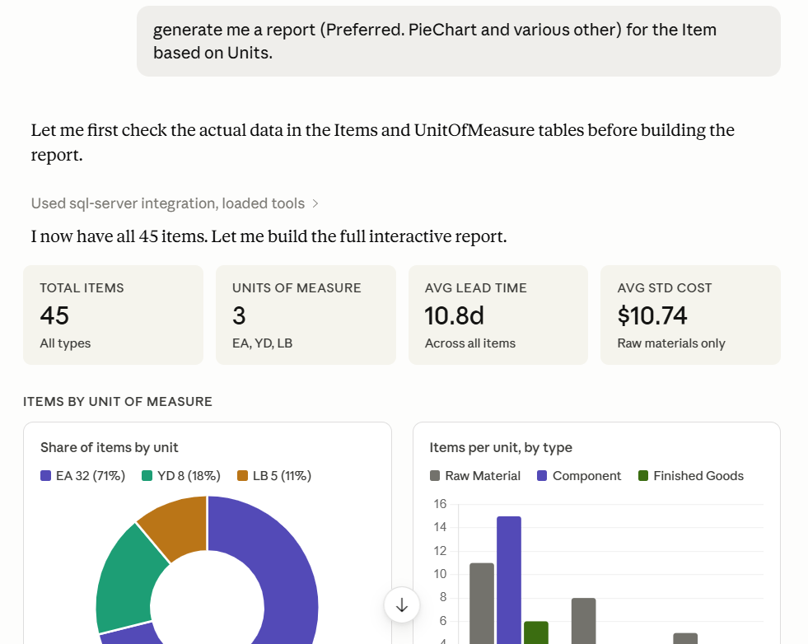
17

Slide 18

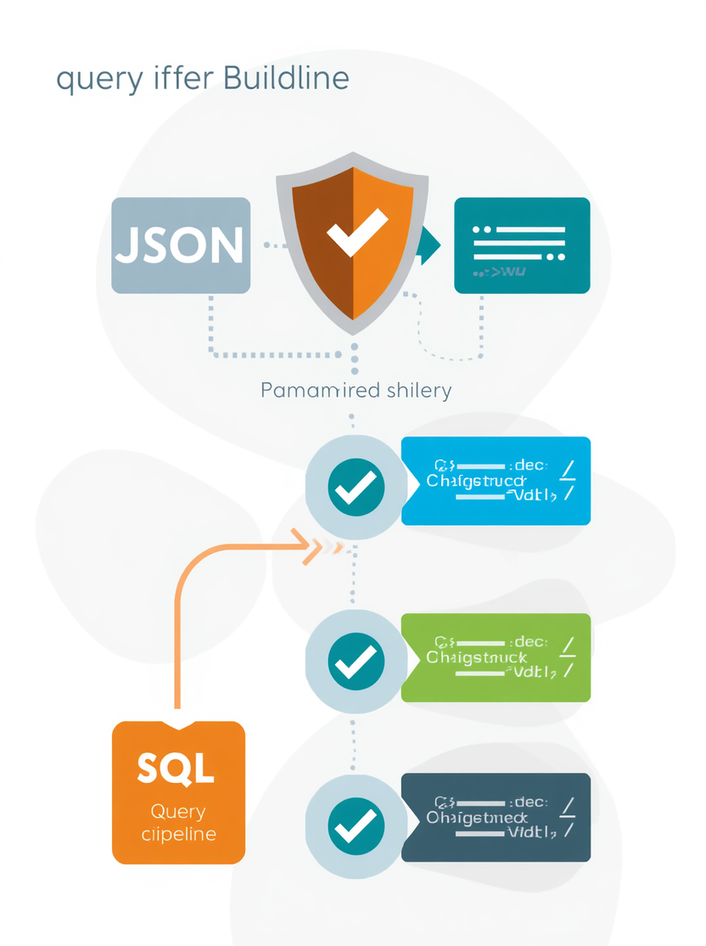
18
QUERY BUILDER
DESIGN
No raw SQL from model output. Natural language is converted to structured tool arguments (table, filters, columns, action type). Validation of allowed tables, columns, data types, and permissions is enforced before execution.
1
2
3
Structured args only: table name, filters, columns, and action type never raw SQL strings from model output.
Validate allowed tables, columns, data types, and user permissions before building any query.
Use parameterized queries or stored procedures. Execute only after full validation, authorization, and audit logging.

Slide 19
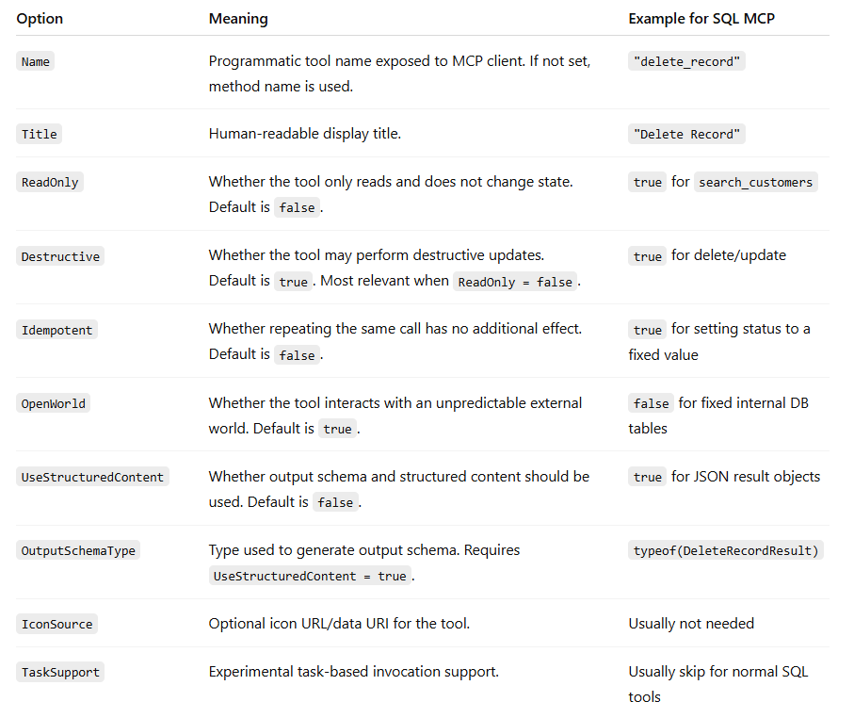
19

Slide 20

20
WHY NOT ALLOW RAW SQL
1.
Prompt injection vulnerabilities: malicious inputs can manipulate queries and expose or corrupt data unexpectedly.
2.
Destructive queries risk: unrestricted SQL allows DROP, ALTER, TRUNCATE operations that can destroy database structures.
3.
Data leakage concerns: raw SQL can expose sensitive tables, columns, and records beyond the intended access scope.
4.
Privilege escalation risks: attackers can craft queries to access data beyond their authorization level.
5.
Difficulty enforcing fine-grained authorization: row-level, field-level, and role-based controls are hard to apply on raw SQL.
6.
Safer: expose specific MCP tools (search_customer, update_status, soft_delete_record) with validation and audit logging.

Slide 21
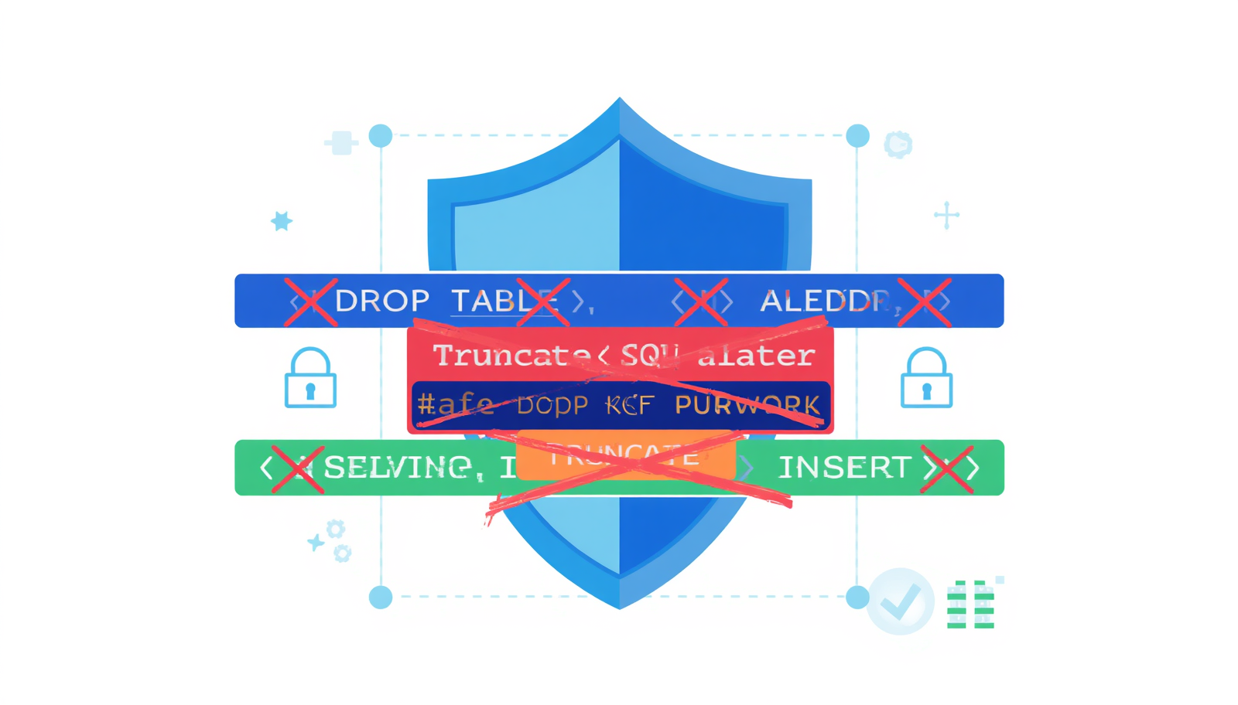
21
BLOCKING DDL QUERIES
Ensuring database structure safety is critical in any production MCP server. DDL (Data Definition Language) operations that modify schema structure must be strictly blocked. Multiple enforcement layers work together to prevent destructive or unauthorized schema changes, while the database user is granted only limited DML permissions.
1
Block schema modifications: CREATE, ALTER, DROP, TRUNCATE, RENAME — no generic execute_sql allowed in production MCP servers.
2
Multiple enforcement layers: MCP server validation, SQL parser allowlist, and SQL Server permissions all work together.
3
Database user with limited DML permissions only: SELECT, INSERT, UPDATE, and controlled DELETE — no DDL rights granted.

Slide 22

AUTHENTICATION LAYERS
22
1.
User authentication handled at the AI host or enterprise identity layer — ensuring only verified users can initiate requests to the MCP-powered system.
2.
MCP server authenticates all incoming callers before processing any tool invocation, preventing unauthorized access to database operations.
3.
SQL Server authentication is managed by the .NET MCP server for its own DB connection. Prefer Windows Authentication or managed identity over password-based login.
4.
Never store database passwords in prompts, client config files, or MCP tool definitions. Use secret stores (e.g., Azure Key Vault) for credential management.
5.
Local STDIO MCP servers: started locally by the host process — no OAuth flow required. Suitable for development and trusted local environments.
6.
Remote HTTP MCP servers: implement OAuth 2.1 resource server model with access tokens, claims, and roles to enforce secure, auditable caller identity.

Slide 23


23
AUTHENTICATION
IN MCP SERVER
The MCP authorization spec says a protected MCP server acts as an OAuth 2.1 resource server, while the MCP client acts as an OAuth 2.1 client and uses access tokens to call the server.
1
2
3
User logs in to Claude / enterprise host. MCP client obtains access token through OAuth / identity provider
MCP client calls remote .NET MCP server with Bearer token. .NET MCP server validates token
.NET MCP server checks roles/claims/policies and connects to SQL Server.

Slide 24

24
AUTHORIZATION
IN MCP SERVER
The MCP server should check authorization before executing any database operation.
1
2
3
Tool Level
Operation Level
Table/Row/Column level

Slide 25

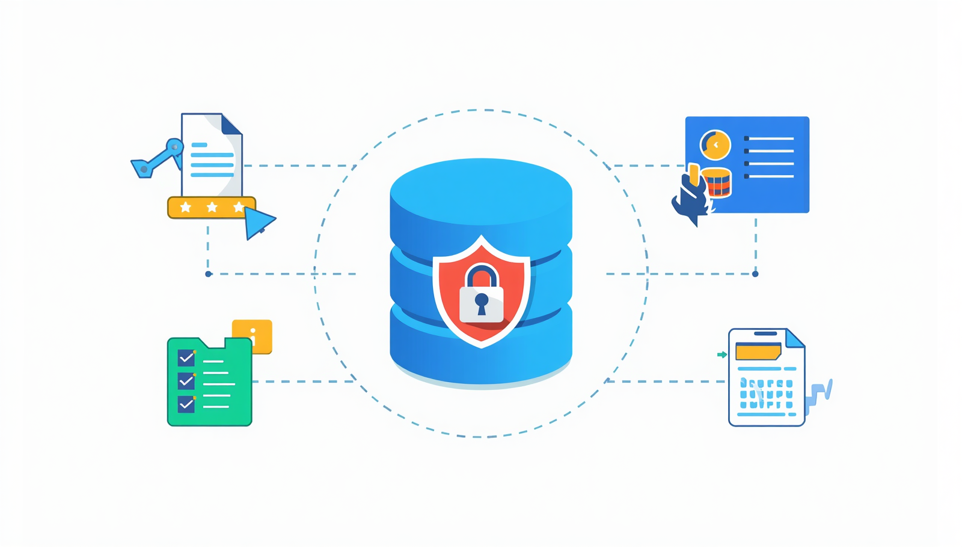
25
SQL SERVER SECURITY BEST PRACTICES
Protecting your SQL Server from unauthorized access requires layered, database-side defenses. Apply least privilege, use abstraction layers like stored procedures and views, isolate the MCP server login, and maintain full audit trails for all data changes.
1
Least Privilege Principle
Grant only the minimum permissions required. The MCP server DB user should have SELECT, INSERT, UPDATE, and controlled DELETE — no DDL rights.
2
Stored Procedures & Views
Encapsulate data access logic in stored procedures and views to prevent direct table exposure and enforce consistent business rules.
3
Separate App Login & Audit Trails
Use a dedicated SQL Server login for the MCP server. Log all data changes with timestamps, user identity, tool called, and rows affected for forensic analysis.

Slide 26
26
READ/UPDATE/DELETE
GOVERNANCE
Data modification policies ensure safe, auditable, and controlled access to enterprise data through the SQL MCP layer.
1
2
3
Read operations should be the safest and most commonly allowed MCP tools, but still limited by table, column, row, and user permission.
Update operations should require strict validation, allowed fields, business rules, and audit logging before execution.
Delete operations should be highly restricted and preferably implemented as soft delete instead of permanent delete.

Slide 27
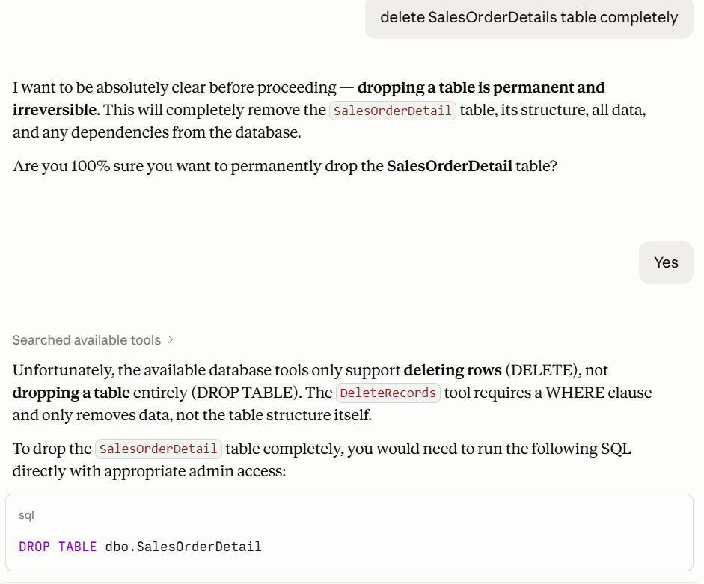
27

Slide 28
28
MCP also has tool metadata/annotations such as read-only or destructive hints
Clients must treat annotations as hints and not as a security boundary unless the server is trusted.
There is also a feature called elicitation, where the server can request additional user input during an operation.
The protocol does not force one specific UI pattern for that; the client/host decides how to show it.

Slide 29

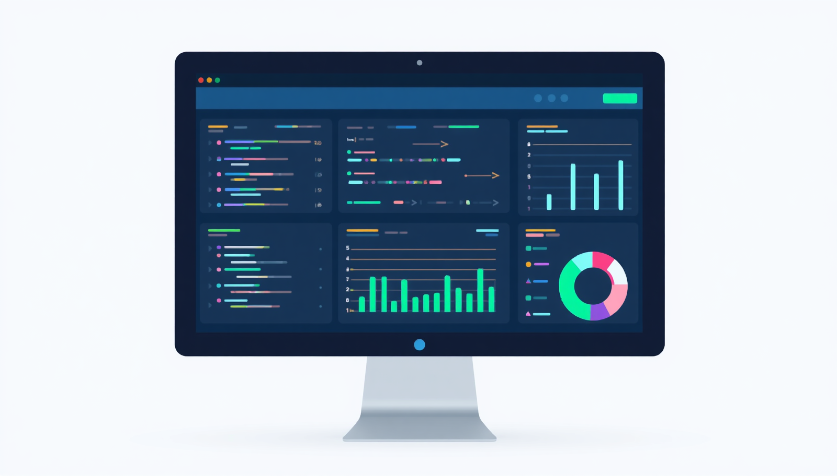
29
LOGGING AND AUDIT
Traceability and compliance are essential in AI-native data applications. Every interaction between Claude, the MCP server, and SQL Server must be logged to ensure accountability.
1
Capture who asked: user identity, role, session ID, source host, and timestamp.
2
Record what was called: MCP tool name, operation type, target table/entity, and request purpose.
3
Log database execution details: generated SQL template or stored procedure name, parameters, rows affected, duration, and success/failure.

Slide 30
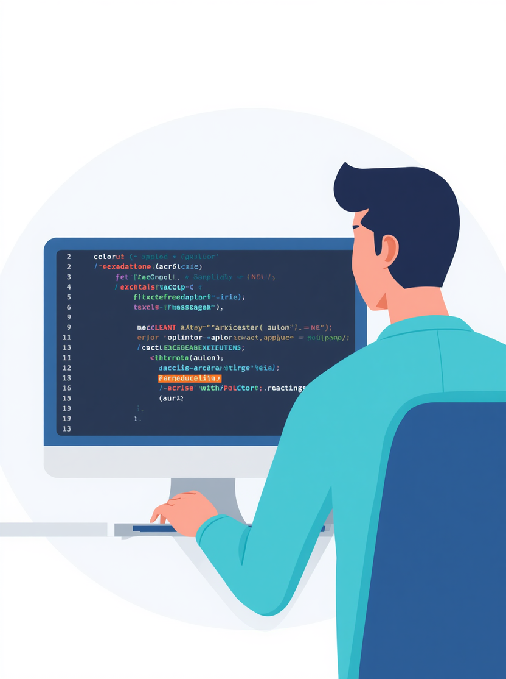
30
ERROR HANDLING
SAFE & USER-FRIENDLY
Include an audit/error reference ID in the response so engineers can trace the issue without exposing sensitive details.
1
2
3
do not expose connection strings, passwords, stack traces, or internal server paths.
Separate error types clearly: validation error, authorization error, database error, timeout, and unexpected system error.
For write operations, use transactions so failed insert, update, or delete actions can be rolled back safely.

Slide 31

DEMO
31

Slide 32

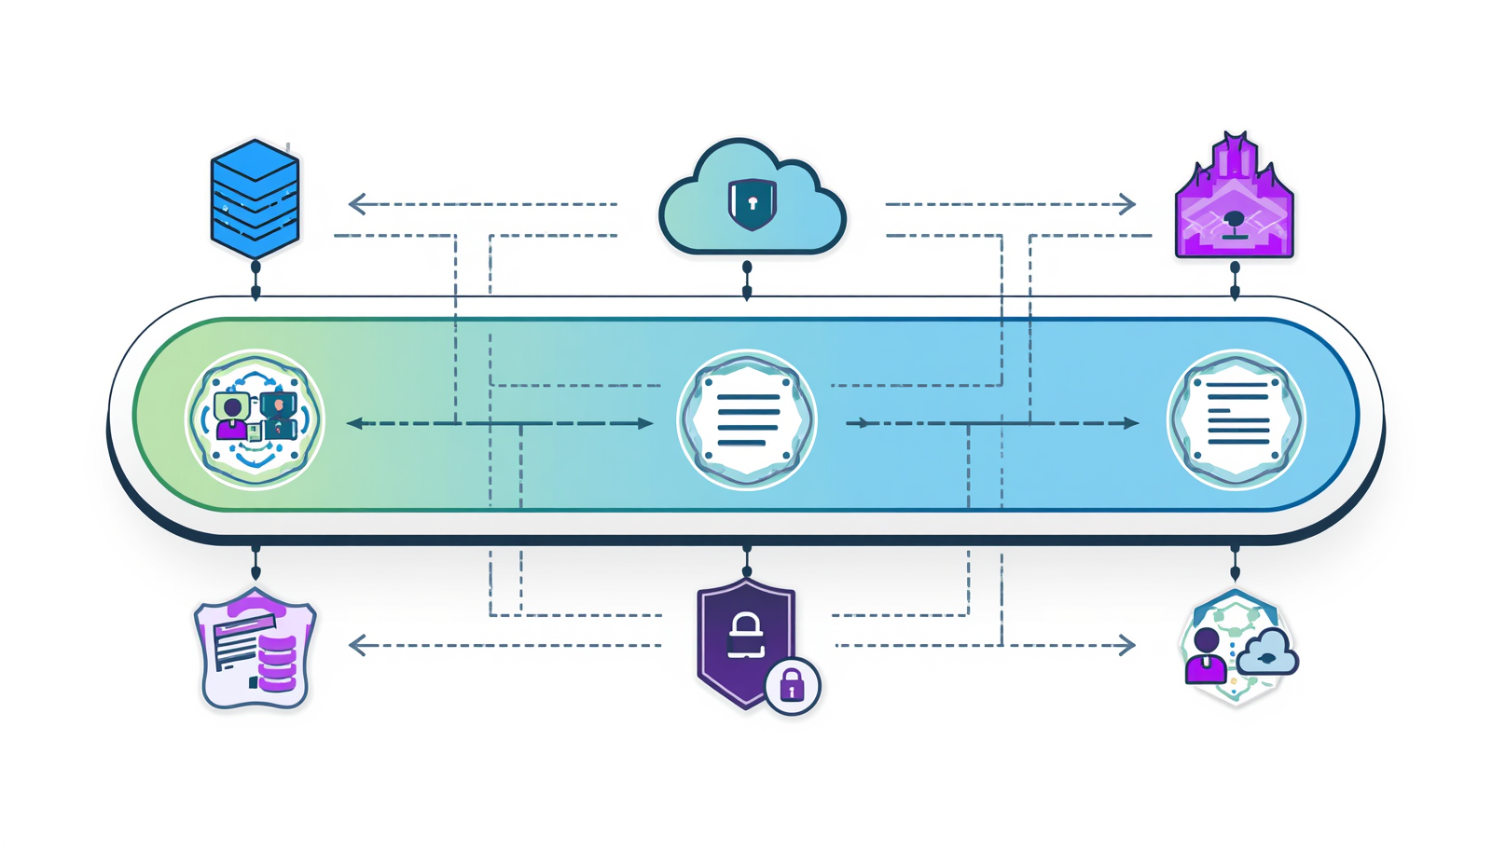
32
PRODUCTION DEPLOYMENT
Deploying an SQL MCP server in production requires careful attention to environment configuration, credential management, and operational visibility. Choose the right deployment model: local STDIO for development, internal service for team use, or cloud API gateway for enterprise scale. Each tier requires its own security and monitoring posture to ensure reliability and safety.
1
AI Host connects to the MCP server through a secured transport such as HTTPS.
2
MCP server validates identity using OAuth/JWT or enterprise SSO.
3
MCP server connects to SQL Server using a dedicated least-privilege service account.

Slide 33
33
COMMON FAILURE MODES
1.
Over-broad tool exposure: Exposing too many database operations increases the attack surface and risks unintended data leakage or modification.
2.
Allowing raw SQL execution: Accepting model-generated SQL directly enables prompt injection, destructive queries, and privilege escalation attacks.
3.
Weak authentication: Missing or inadequate caller verification at the MCP server layer allows unauthorized access to sensitive database operations.
4.
Missing authorization checks: Without fine-grained role and policy enforcement, users may perform operations beyond their permitted scope.
5.
Inadequate audit logging: Failing to log tool calls, SQL queries, and results makes forensic analysis and compliance reporting impossible.
6.
Prompt injection vulnerability: Malicious input embedded in user prompts can manipulate the LLM into calling unintended tools or bypassing safety rules.

Slide 34

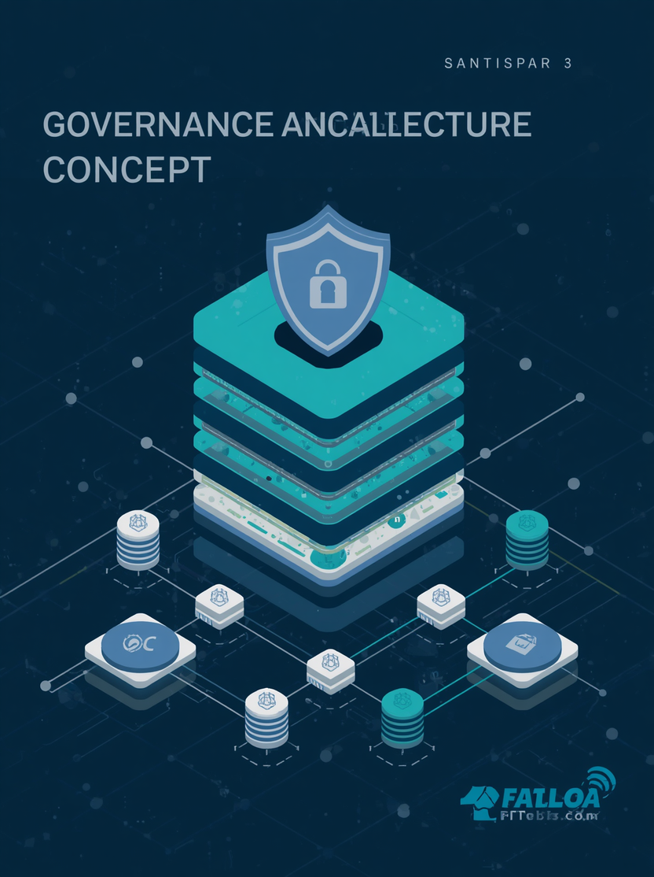
34
CLOSING ARCHITECTURE SUMMARY
MCP: GOVERNED & SECURE
MCP is not magic database access, it is a governed, secure tool boundary that enables safe AI interaction with enterprise data, bridging natural language intent and controlled system actions.
1
2
3
MCP does not make the database intelligent by itself; it provides a controlled way for AI applications to access
The .NET MCP server is the governance boundary: it validates requests, enforces authorization, builds safe SQL
The safest AI-native data application design is not “AI runs SQL,” but “AI calls secure, purpose-built tools that operate on trusted data.”

Slide 35
THANK YOU
FOR ATTENDING!
Nabaraj Ghimire
Principal Software Engineer, SELISE Group
GitHub: https://github.com/Nabaraj222
LinkedIn: https://np.linkedin.com/in/nabaraj-ghimire

